Slide 1
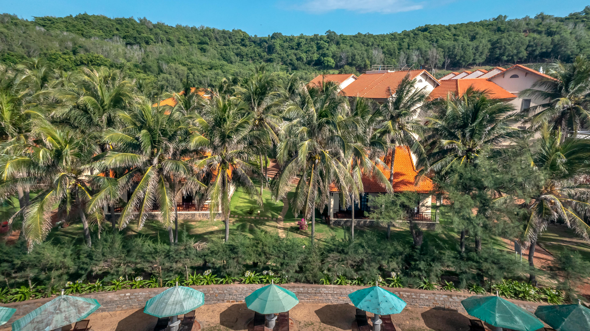
HOSPITALITY ANALYTICS

Slide 2
INDEX
Project Overview
High-Level KPIs: Total Revenue, Total Booking, Utilized Capacity
KPI: Occupancy Rates
KPI: Booking Status (Cancellation Rate, Checked Out, Cancel, No Show)
KPI: Weekday vs. Weekend Revenue and Bookings
KPI: Revenue by State & Hotel
KPI: Class-Wise Revenue
KPI: Trend Analysis (Weekly Revenue, Bookings, and Occupancy)
Excel Dashboard
SQL Queries
Tableau Dashboard
PowerBI Dashboard
Challenges Faced
Conclusion & Strategic Recommendations

Slide 3
Project Overview
Objective: To evaluate property performance across key hospitality metrics to identify revenue opportunities and operational inefficiencies.
Scope: Analysis of 134.59K historical bookings across multiple cities (Mumbai, Bangalore, Hyderabad, Delhi) and various hotel categories.
Key Focus Areas: Revenue generation, capacity utilization, customer booking behaviors, and cancellation trends.

Slide 4
Total Revenue & Total Booking
Data Summary: Total Revenue: ₹ 1,708,771,229 (~₹1.71 Billion) , Total Bookings: 134,590
Observations: The portfolio generated over ₹1.7 billion across approximately 134.5k bookings during the analyzed period.
Findings: There is a strong baseline of demand and revenue generation. However, analyzing these top-line figures against capacity and cancellations will reveal the actual net performance.

Slide 5
Utilize Capacity
Data Summary: Total Capacity: 232,576 room nights.
Observations: The total available room nights across all properties stands at over 232,000, while total bookings are only 134,590.
Findings: There is a gap of nearly 100,000 unbooked room nights. This massive unutilized capacity represents the biggest area of opportunity for revenue growth without needing physical expansion.

Slide 6
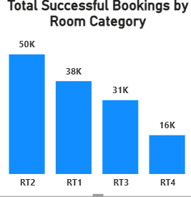
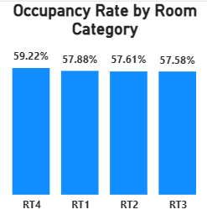
Occupancy
Overall Average Occupancy: 57.87%
Findings: The properties are operating at little more than half their potential. Marketing and pricing strategies need an aggressive overhaul to push occupancy closer to the 70-75% industry standard.

Slide 7
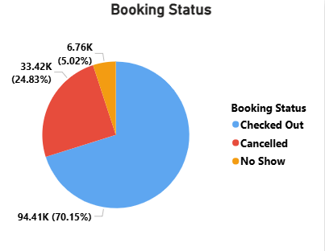
Checked Out, Cancel, No Show
Total Bookings 134.59k
Findings:
A 25% cancellation rate impacting revenue predictability.
Booking policies are either too lenient or customers are finding better last-minute alternatives
"No Shows" alone account for nearly 6,800 lost opportunities where rooms could not even be resold.
Stricter deposit policies or overbooking algorithms are required to mitigate this loss.

Slide 8
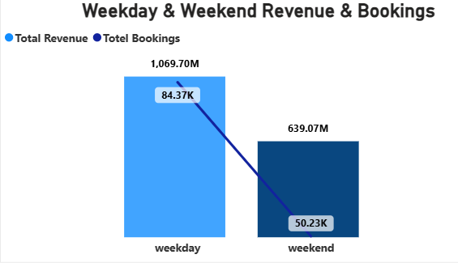
Weekday & Weekend Revenue and Booking
Weekdays 62.6%
Weekend 37.4%
Findings:
The properties have a very strong corporate/business travel base, but are failing to attract weekend leisure travelers.
Weekend-specific promotions are urgently needed to balance the revenue stream

Slide 9
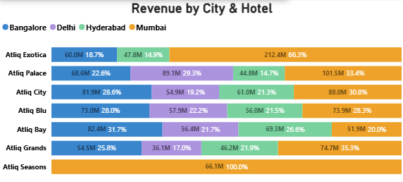
Revenue by State & Hotel
Findings:
Mumbai is the undisputed cash cow. Delhi properties are underperforming relative to the rest of the portfolio and require a targeted market analysis to identify the root cause of the lag.

Slide 10
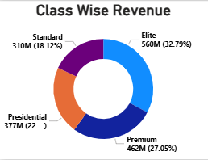
Class Wise Revenue
Findings: Customers utilizing these properties show a strong preference (and willingness to pay) for upgraded experiences.
Marketing should heavily feature premium amenities, as this is where the core revenue lies.

Slide 11
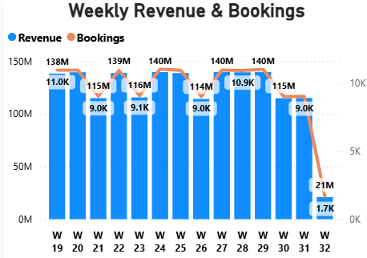
Weekly Trend Analysis
Observations: Revenue and bookings follow a highly cyclic pattern, spiking to ~11,000 bookings and dropping to ~9,000 bookings in alternating bi-weekly cycles.
Findings: Demand is highly predictable. Staffing, housekeeping, and dynamic pricing models should be strictly aligned with these known bi-weekly peaks and valleys to optimise operational costs.

Slide 12
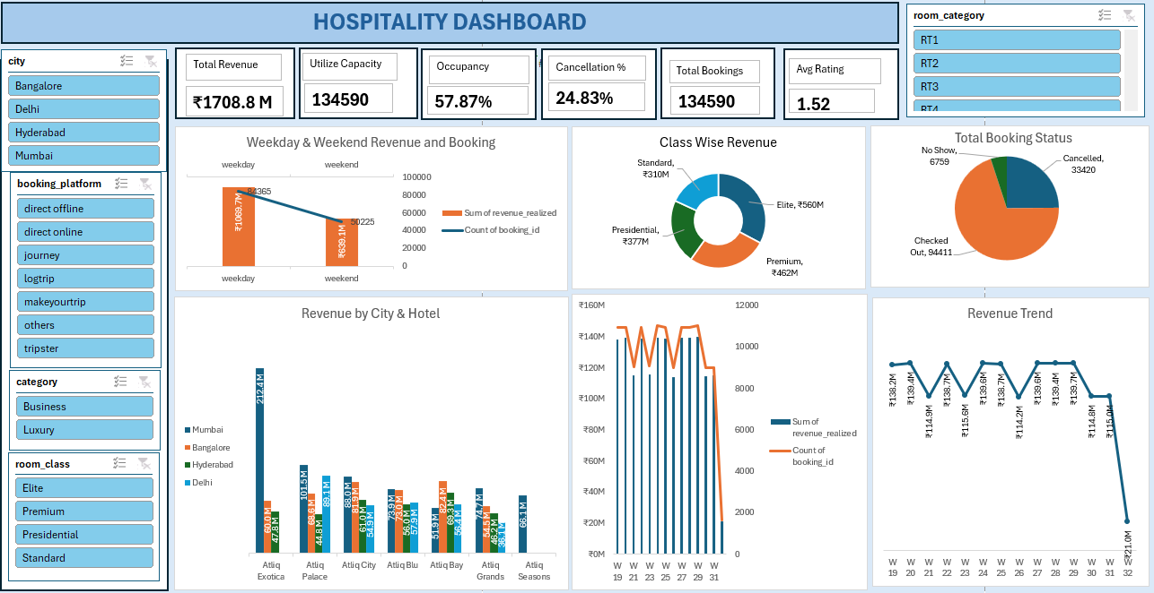
Excel Dashboard

Slide 13
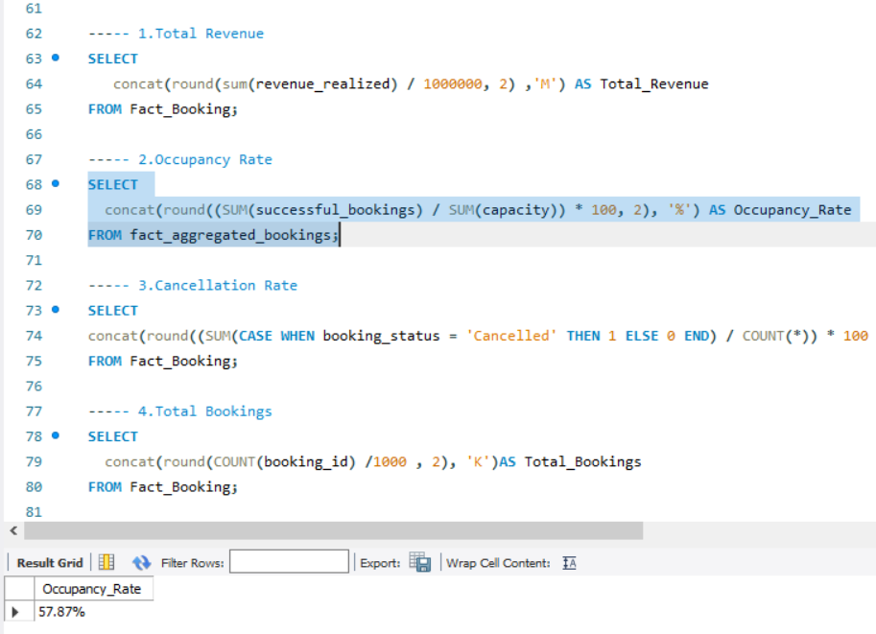
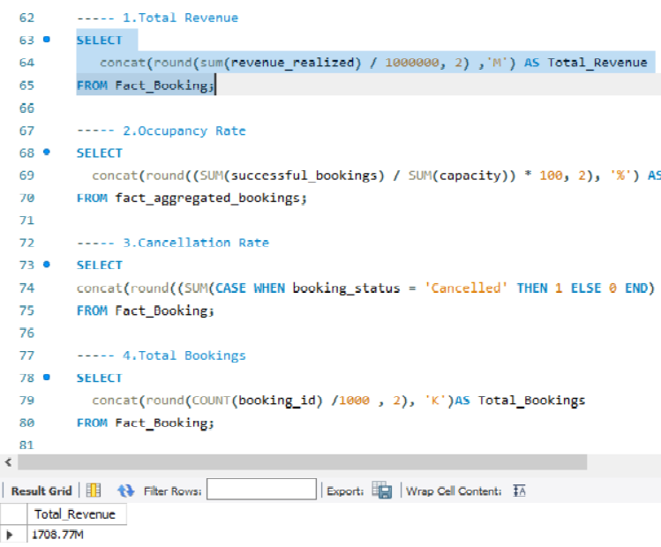
SQL QUERIES

Slide 14
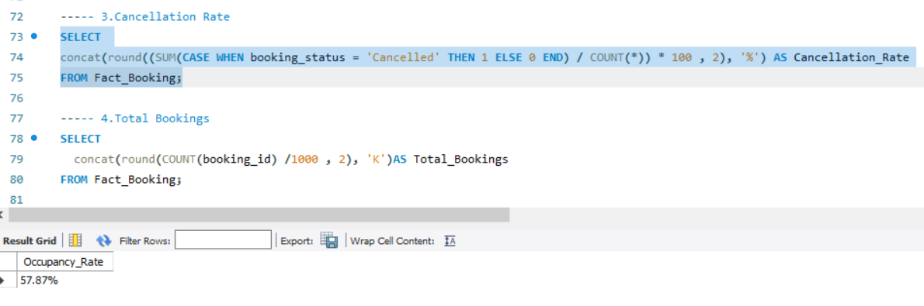
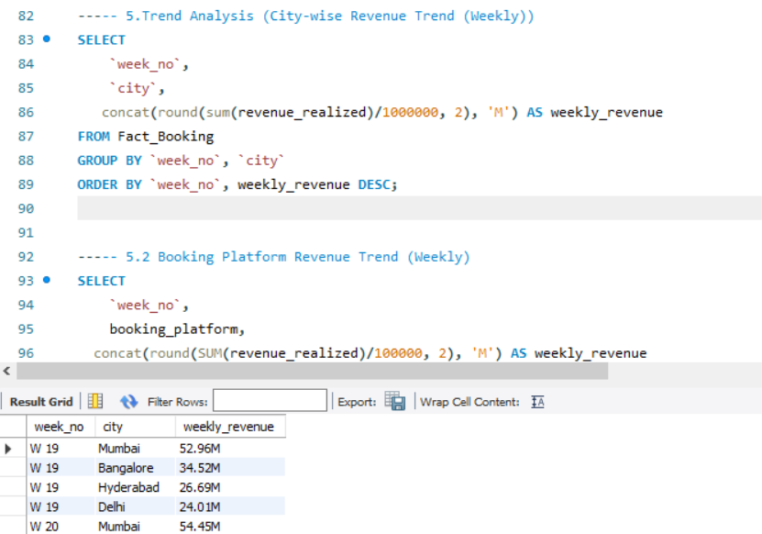
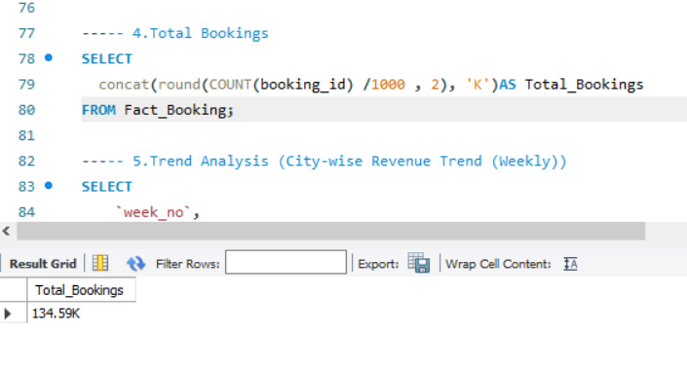

Slide 15
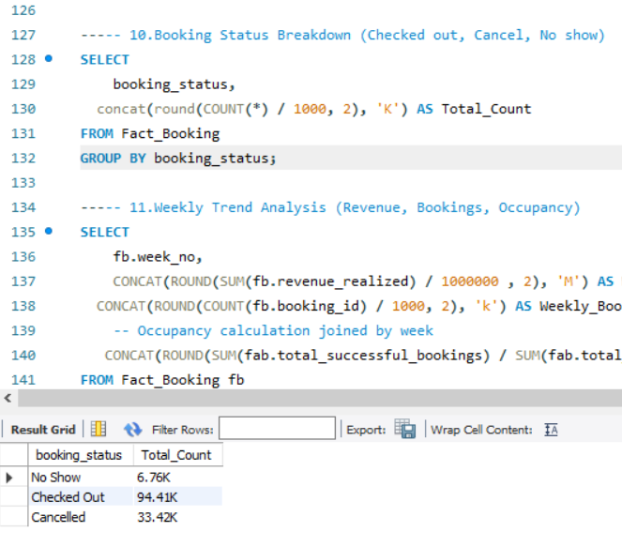
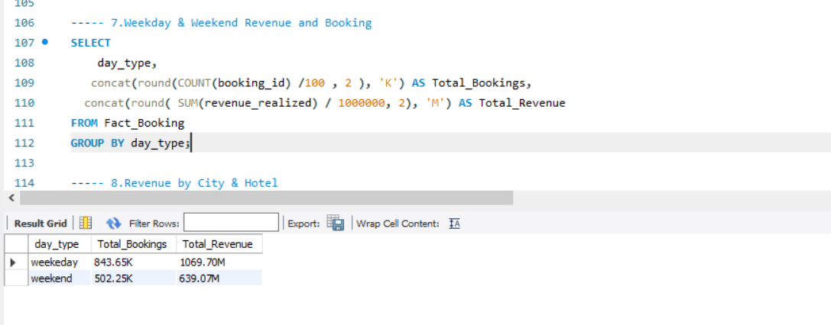
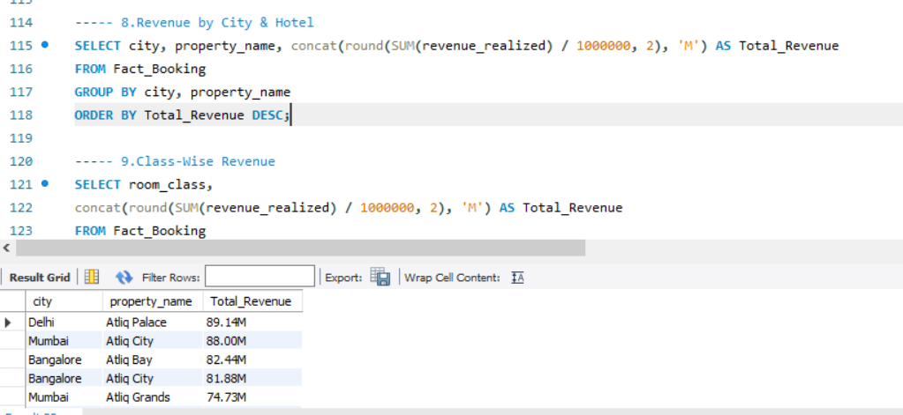
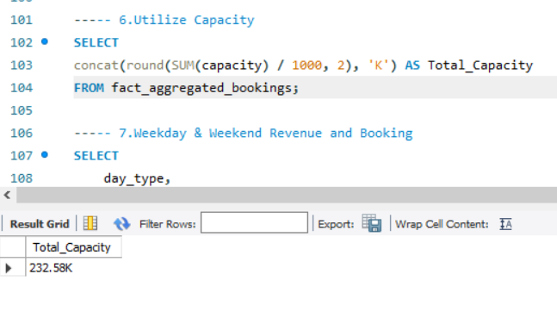

Slide 16
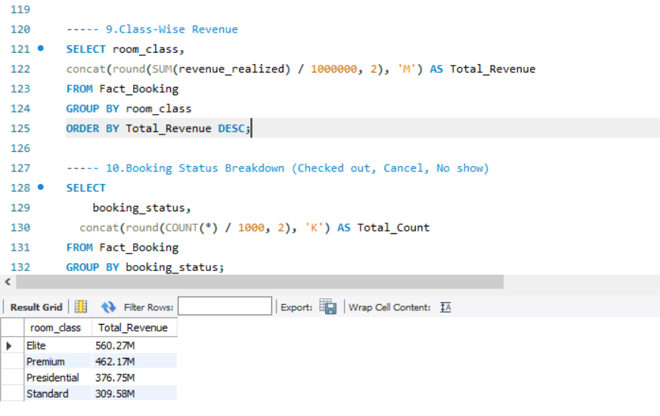
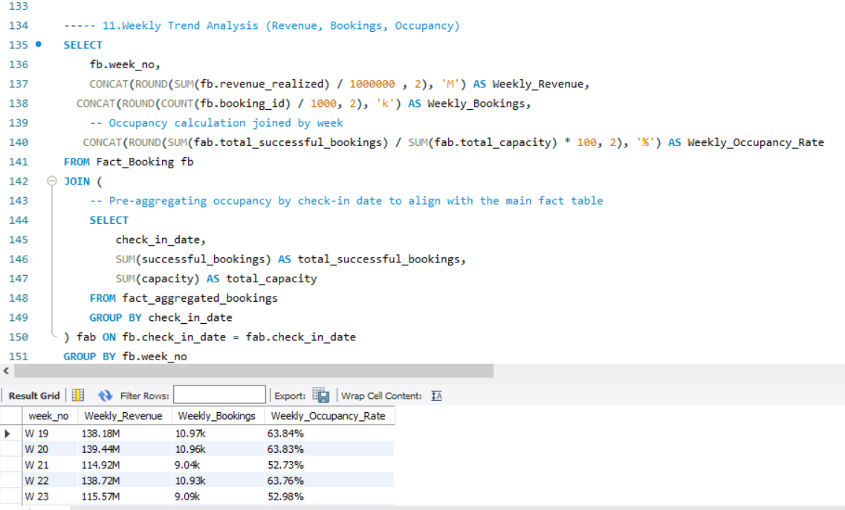

Slide 17
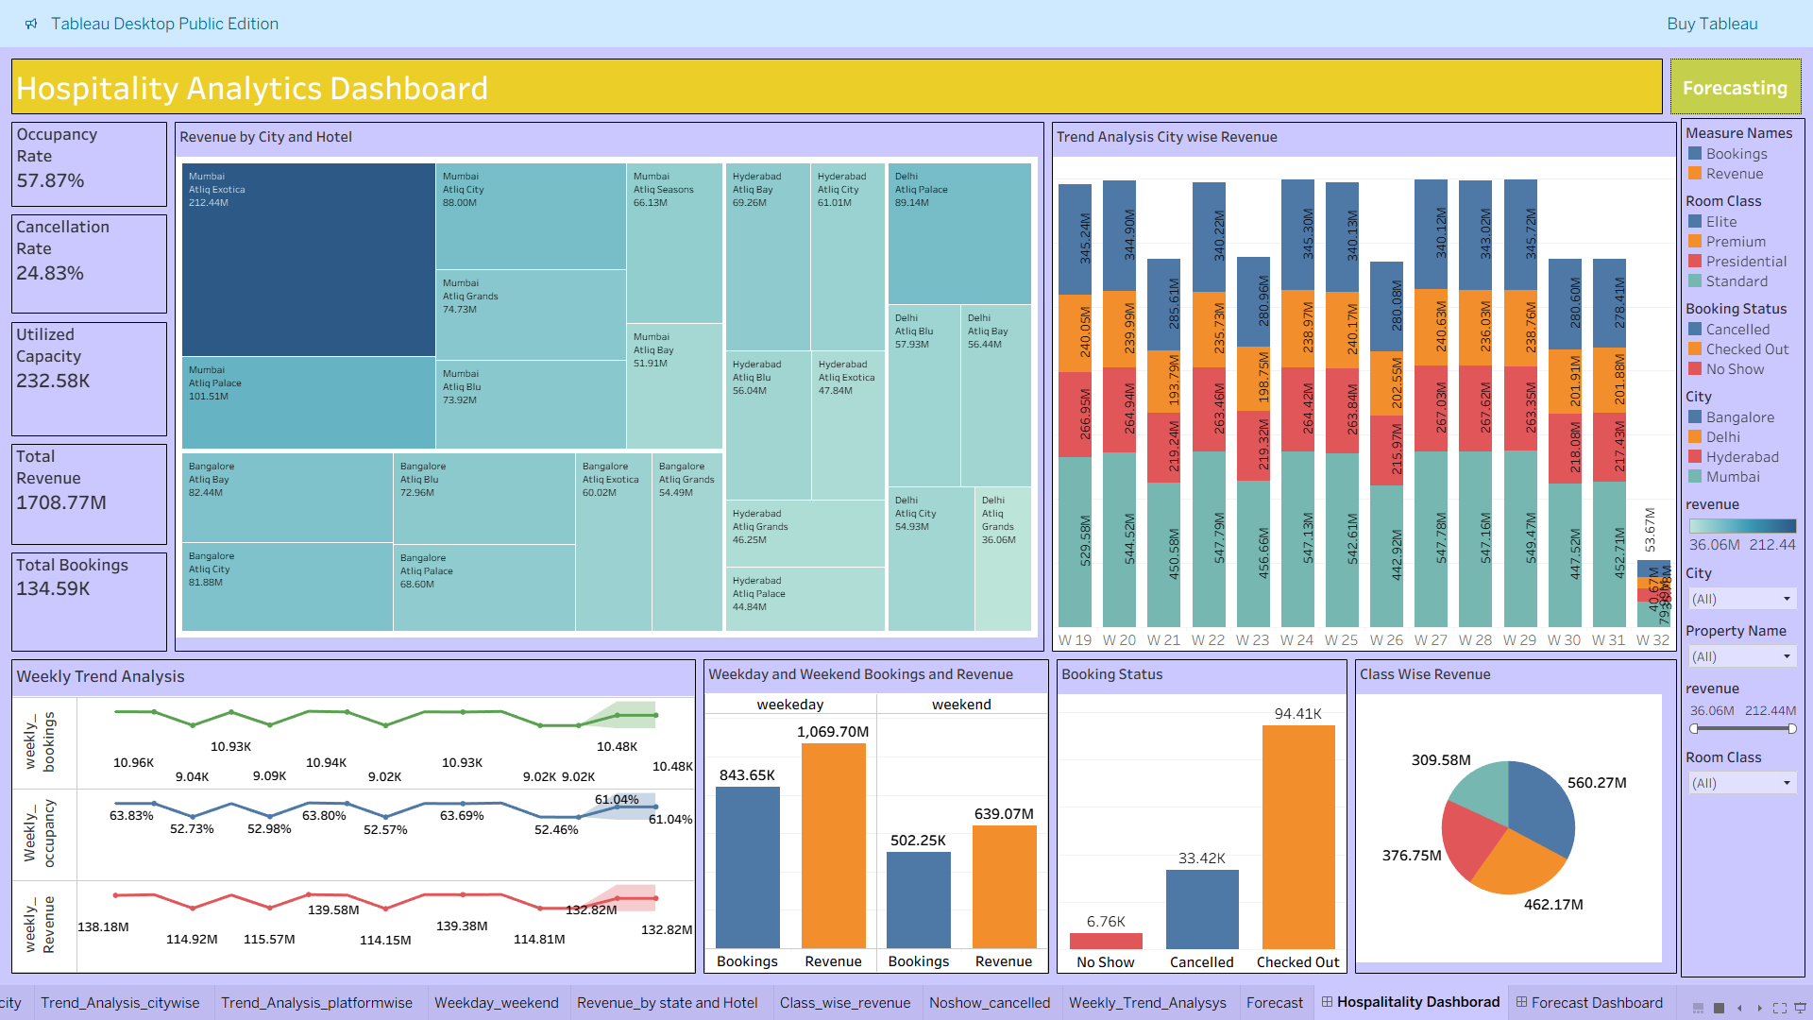
Tableau Dashboard

Slide 18
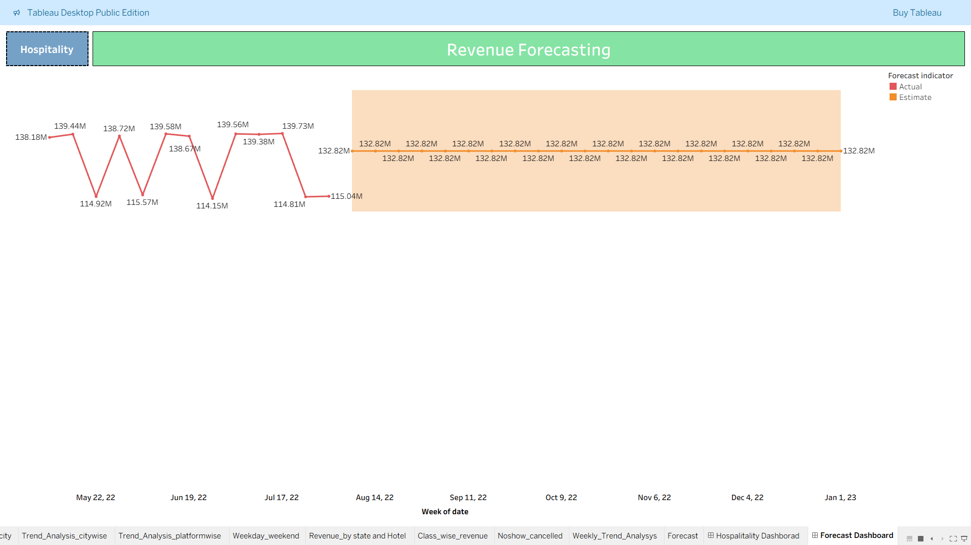

Slide 19
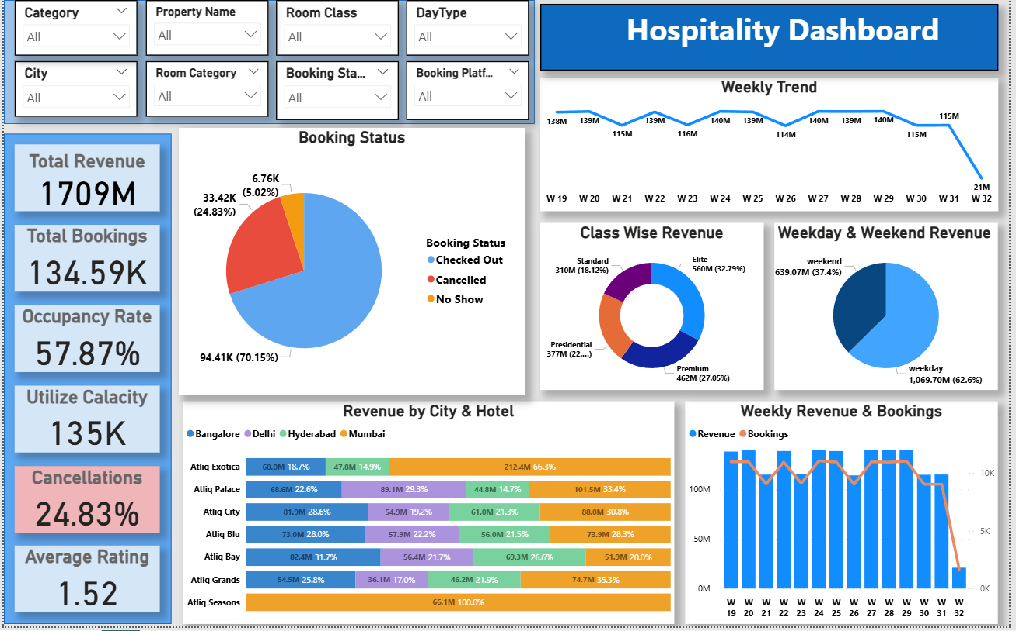
PowerBI Dashboard

Slide 20
Challenges
Handling Large-Scale Data & Performance: Managing and profiling a raw dataset of over 134,000 rows caused initial processing constraints in Excel, requiring efficient data ingestion and handling strategies to prevent lag.
Complex Data Modeling & Relationships: Designing a robust Star Schema in Power BI and structuring precise JOIN operations in SQL to unify fragmented dimensional data (Hotels, Rooms, Dates) without duplicating revenue records.
Advanced Metric Derivation: Formulating conditional SQL logic alongside dynamic DAX measures and Tableau Level of Detail (LOD) expressions to accurately calculate complex KPIs—such as differentiating between revenue_generated and revenue_realized based on cancellation statuses.
Cross-Platform Data Consistency: Maintaining absolute metric accuracy across the entire data pipeline. It was critical to ensure that top-line figures (like the ₹1.71B total revenue and 57.87% occupancy rate) matched perfectly from the initial Excel cleaning phase, through SQL transformations, and onto the final Power BI and Tableau dashboards.
Dynamic Visual Optimization: Rendering highly granular, interactive visualizations (like Weekday vs. Weekend splits and bi-weekly trend cycles) in Power BI and Tableau without compromising dashboard loading speeds or user experience.

Slide 21
Conclusion
Summary: While the properties generate an impressive ₹1.71 Billion primarily through Elite rooms and the Mumbai market, operational inefficiencies are masking the true potential. The combination of 58% occupancy and a 25% cancellation rate means the business is leaving millions on the table.
Strategic Next Steps:
Revamp Cancellation Policies: Introduce non-refundable rates at a slight discount to secure guaranteed revenue.
Boost Weekend Leisure: Create family or "staycation" packages specifically targeted at weekend travelers to lift the weekend slump.
Apply the Mumbai Playbook: Investigate the operational and marketing strategies of Atliq Exotica (Mumbai) and implement those best practices in Delhi and Hyderabad.

Slide 22
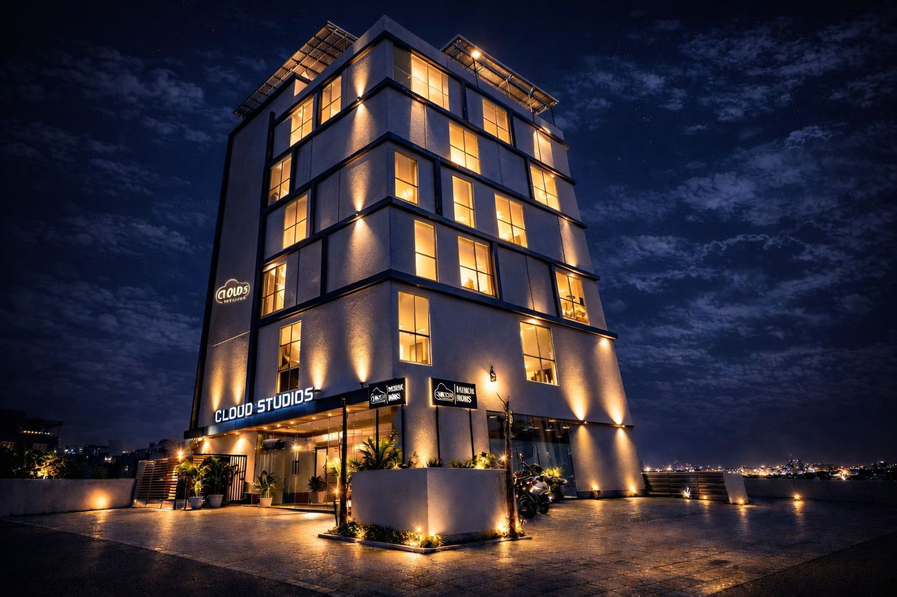
THANK YOU

